Slide 1
Chapter 5

Slide 2
Objectives

Slide 3
Objectives (cont.)

Slide 4
The Future Value program with a logic error

Slide 5
The goal of testing

Slide 6
The three types of errors that can occur

Slide 7
A Python function that contains errors

Slide 8
Common syntax errors

Slide 9
Problems with names and values

Slide 10
Problem with floating-point arithmetic

Slide 11
The Miles Per Gallon program with valid data

Slide 12
Starting to test the Future Value program with invalid data

Slide 13
The Future Value program as it’s tested with valid data

Slide 14
The two critical test phases

Slide 15
How to make a test plan for the critical phases

Slide 16
Two common testing problems

Slide 17
A function that uses print() functions to trace execution

Slide 18
The data that’s printed to the console

Slide 19
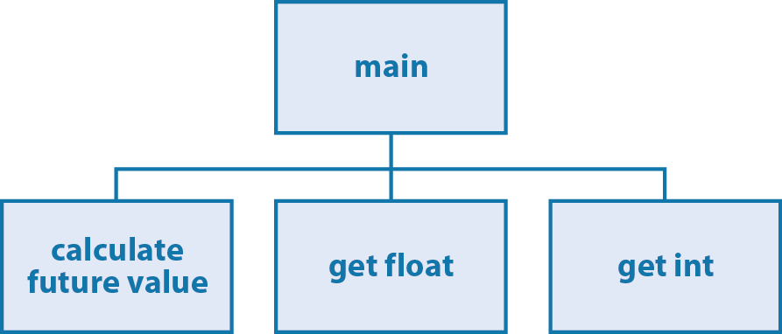
A hierarchy chart for a Future Value program

Slide 20
Testing phase 1: The main() function and the calculate function

Slide 21
Testing phase 2: Add data validation for float entries

Slide 22
Testing phase 3: Add data validation for int entries

Slide 23
Testing phase 4: Add the finishing touches

Slide 24
Testing the functions of the Future Value program in the Python shell

Slide 25
Testing the functions of the temperature module in the shell

Slide 26
Testing the functions of the Convert Temperatures program in the shell

Slide 27
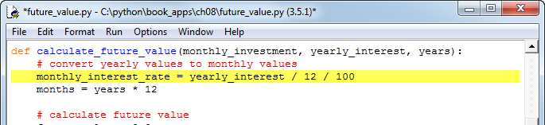
The IDLE editor window with a breakpoint

Slide 28
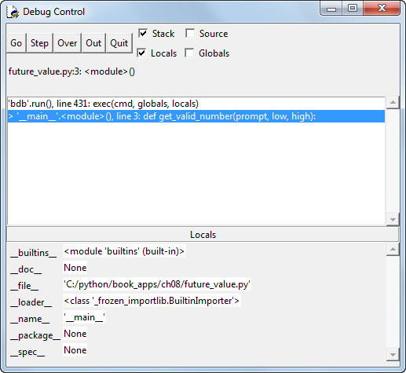
The IDLE Debug Control window when the Future Value program starts

Slide 29
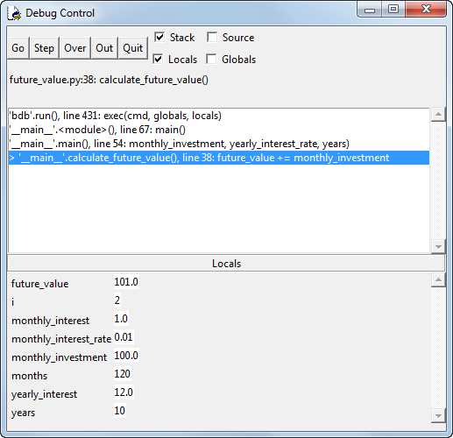
The IDLE Debugger when the Future Value program is running

Slide 30
Some of the buttons on the Debug toolbar

Slide 31
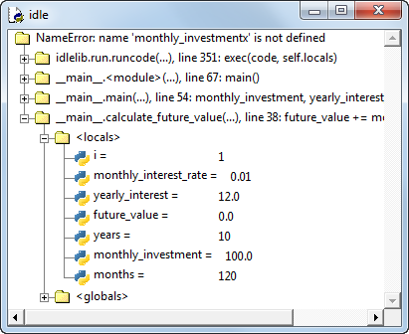
A debugging session with the Stack Viewer window displayed

